Slide 1

Precipitation prediction
Dor sandler
Rotem balter
Roni admon

Slide 6
CASPNET
Sara Sabour, Nicholas Frosst, Geoffrey E Hinton. Dynamic Routing Between Capsules. NIPS 2017
Xifeng Guo - https://github.com/XifengGuo/CapsNet-Keras

Slide 7
CASPNET
Originally trained on MNIST, detecting multiple classes
Motivation: pattern recognition
Key feature – Routing by agreement

Slide 8
Capsules
Usually in a Neural Network we care about the existence of the pattern, but in order to know how it exists we use a concept called capsules
We call a group of neuron a capsule and refer to the relation between them – an object is made from several parts and it only exist if all the parts exist in the proper manner

Slide 9
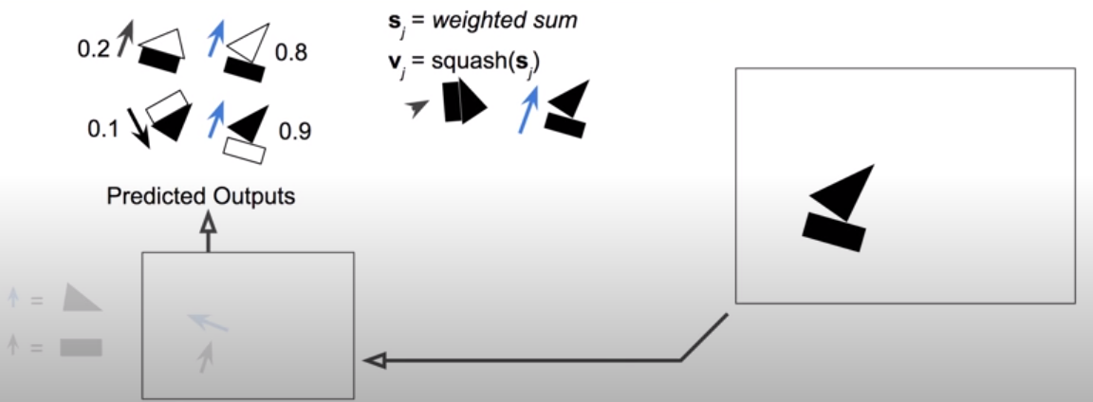
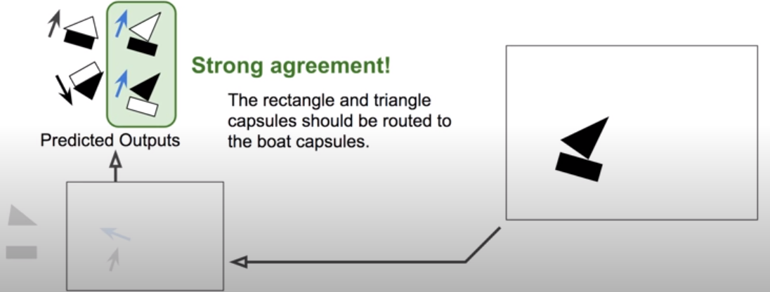
Routing by agreement
Summing the vectors – low level capsules
Finding clusters of agreement and routing only them to higher level capsules
We used 5 routing iteration
Notes:
Take for example this picture on the right which is complexed from a triangle and a rectangle , and let say it can make a house or a boat, so we have 2 higher capsules
each part separately tries to predict the whole object’s size and direction, thus also for the other parts

Slide 10
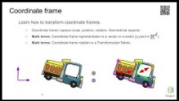

Slide 11
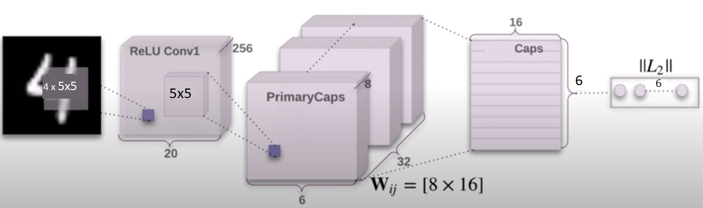
Starts as fully connected

Slide 12
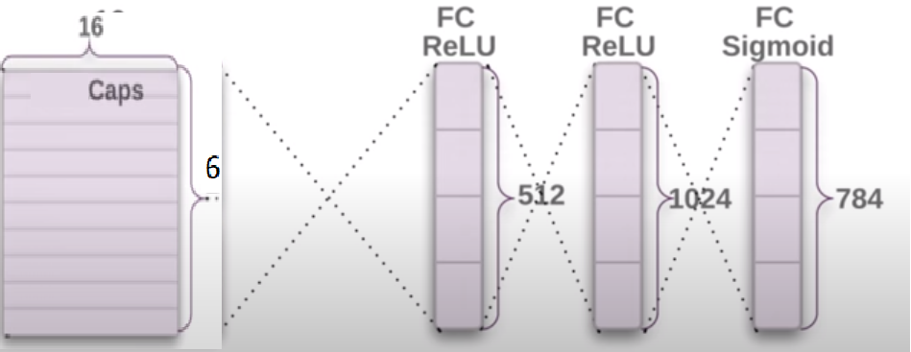
Decoder – reconstructing image

Slide 13
Pros // Cons
Requires less training data
Routing by agreement is great for overlapping
Position and pose data are preserved
Activations nicely map hierarchy of parts
Cannot see 2 identical very close objects (crowding)
Routing by agreement inner loop makes slow training

